Slide 1





Slide 2
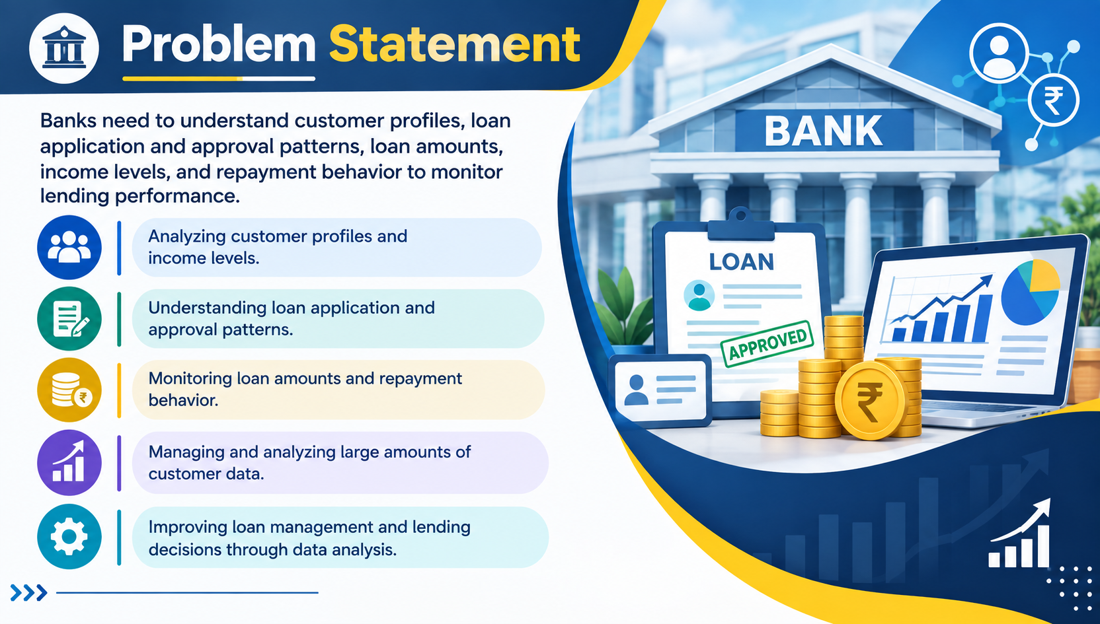

Slide 3


Slide 4
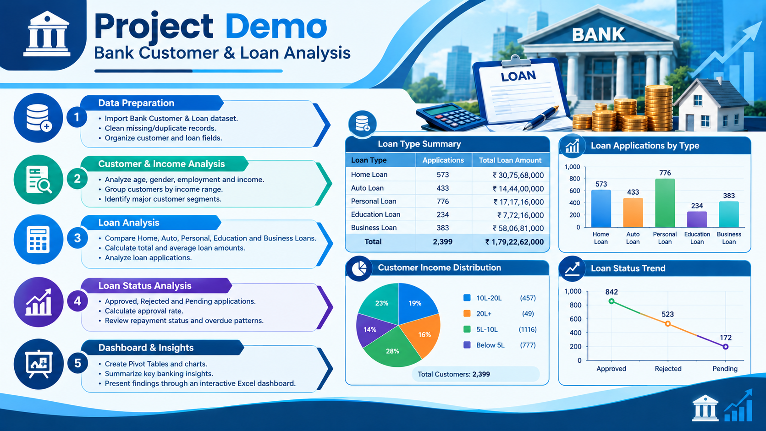

Slide 5


Slide 6



Slide 7

Thankyou
Notes:
Thank You !!

